Slide 1
Student placement analysis
Project title
Gulfam shaikh
Md. Kaif Jamadar
Atharv savai
Mohit Dhande
Khushi Shinde
Gayatri Jadhav
Laxmi Kashette

Slide 2
Introduction
A Student Placement Analysis Project involves collecting and analyzing data related to the placement of students after completing their academic programs. The goal of this project is to identify key factors that influence successful placements, such as academic performance, And Percentage of 10th ,12th and Degree.
The analysis helps to uncover trends and patterns in student employability, aiding educational institutions, students

Slide 3
Day 1&2- Jira
Jira is a software tool used for tracking and managing tasks, projects, and issues. It is popular among teams for planning, tracking progress, and collaborating on projects, especially in software development using Agile methodologies like Scrum or Kanban
Features of Jira* - Issue tracking - Project management - Agile boards (Scrum and Kanban)
Jira Components* - Epics - Stories - Tasks - Subtasks - Bugs

Slide 4
Day 3 –Agile Methodology
Agile Methodology is a flexible and iterative approach to software development and project management that focuses on delivering small, incremental changes frequently and adapting to changes quickly based on customer feedback. It emphasizes collaboration, continuous improvement, and customer satisfaction by breaking the project into smaller parts called sprints or iterations, each delivering a working product.

Slide 5
Day 5&6 Pandas
Pandas is a powerful, fast, and flexible data manipulation and analysis library in Python. It provides data structures like Series and DataFrame to efficiently handle and manipulate structured data (e.g., tables, spreadsheets, time series). Pandas is widely used in data analysis, data cleaning, data visualization, and machine learning tasks.
Series: A one-dimensional labeled array that holds data of any type.
DataFrame: A two-dimensional labeled data structure, similar to a table or spreadsheet.
Method & properties: df.head(), df.tail(), df.describe(), df.isnull(), df.fillna(), df.dropna(), df.groupby()

Slide 6
Day 7&8 NumPy
It is the powerful python library which is used for numerical computing in python.It is also known as the (Numerical Python).
NumPy Data Structures: 1D Array (Vector): np.array([1, 2, 3, 4, 5]),
2D Array (Matrix): np.array([[1, 2, 3], [4, 5, 6]]), 3D Array : np.array([[[1, 2], [3, 4]], [[5, 6], [7, 8]]])
Common NumPy Operations: np.array([1, 2, 3]), arr.shape, arr.reshape(2, 3), np.zeros((2, 2)), np.ones((3, 3)), np.random.rand(3, 2).

Slide 7
Day 9&10 Mat plot
A module in Matplotlib used to create visualizations in Python.
Commonly imported as: python import matplotlib.pyplot as plt
Key Functions - plt.plot(), Line plots, plt.bar(),Bar charts , plt.scatter(), Scatter plots,plt.boxplot(),Box plots, plt.hist(), Histograms, plt.title(), plt.xlabel() / plt.ylabel(), plt.legend() ,plt.show()

Slide 8
Day 11&12 Excel
Microsoft Excel is a widely used tool for data analysis due to its versatility, user-friendly interface, and powerful built-in features. It allows users to organize, manipulate, analyze, and visualize data with ease. Excel is especially popular for small to medium datasets and is frequently used in business reporting, financial analysis, and data visualization.
Steps to Perform Data Analysis in Excel: 1)Import Data: Load data from CSV 2)Data Cleaning: Handle missing values, duplicates, and inconsistencies
3)Data Transformation: Use functions to calculate,
filter, sort, and group data.

Slide 9
Day 13&14 SQL
SQL (Structured Query Language) is a powerful language used to manage, manipulate, and analyze data stored in relational databases. In data analysis, SQL plays a vital role by helping analysts retrieve, filter, clean, and transform data efficiently from large datasets stored in databases.
Data Extraction, Data Cleaning, Data Transformation Data Analysis and Reporting
How to Use MySQL 1. Creating a Database: 2. Creating a Table: 3. Importing Data into MySQL - Open Schemas → Right- click → Select Data Import Wizard.-> Provide file link, click Next until import completes.
4. Running Queries

Slide 10
Day 15&16 Solving Query
1.Student performance Analysis
2.Geographical distribution
3.Stream wise performance
4.Yearly performance trends
5.Top performance identification
6.Correlation Analysis
7.Failure rates
8.Gender or diversity insights
9.Academic progression
10.Stream popularity

Slide 11
Day 17 PowerBI
PowerBI – (Power Business Intelligence) Introduction to Powerbi.
Purpose and Why to use PowerBI: Transform raw data into attractive visual insights with the help of the visualization tools like powerbi.
Features of PowerBI: Connect to data, create interactive dashboards, and perform advanced analytics.

Slide 12
Day 18&19 PowerBI
1. Import Data: Learn how to import data from Excel, SQL, etc.
2. Table View: View, inspect, and manage tables in *Data View*.
3. Relationships: Use **Inner/Left Joins* to link tables in *Model View*
New Columns: Perform custom calculations and created the additional columns. Which are needed to analyse the data easily .
Examples: - Total Sales = SUM(Sales[Amount])
- Profit Margin = DIVIDE([Profit], [Revenue]).

Slide 13
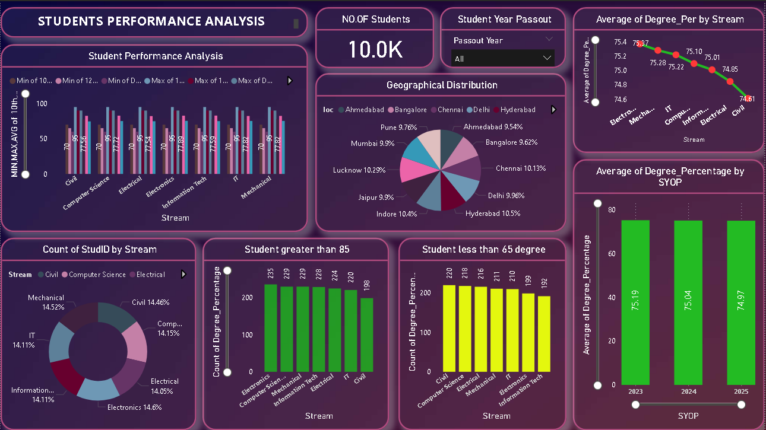
Kaif Dashboard

Slide 14
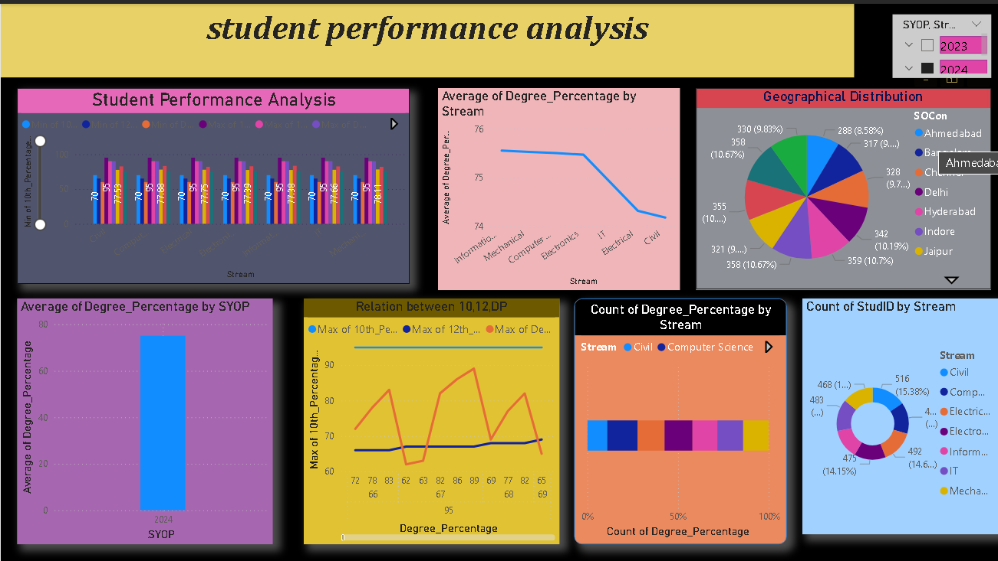
Gayatri Dashboard

Slide 15
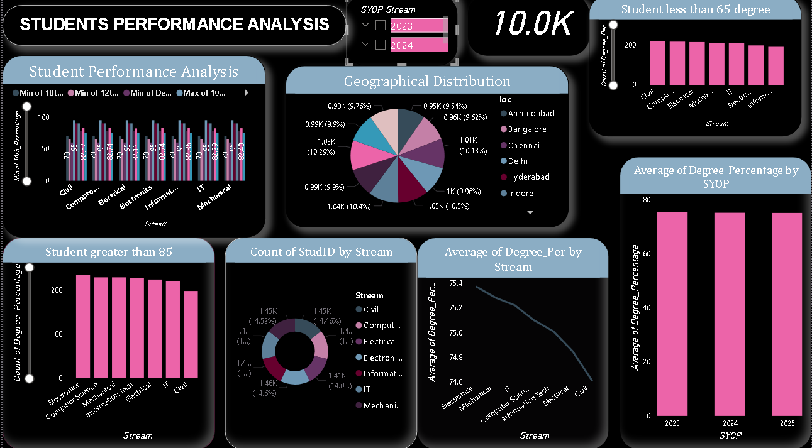
Khushi Dashboard

Slide 16
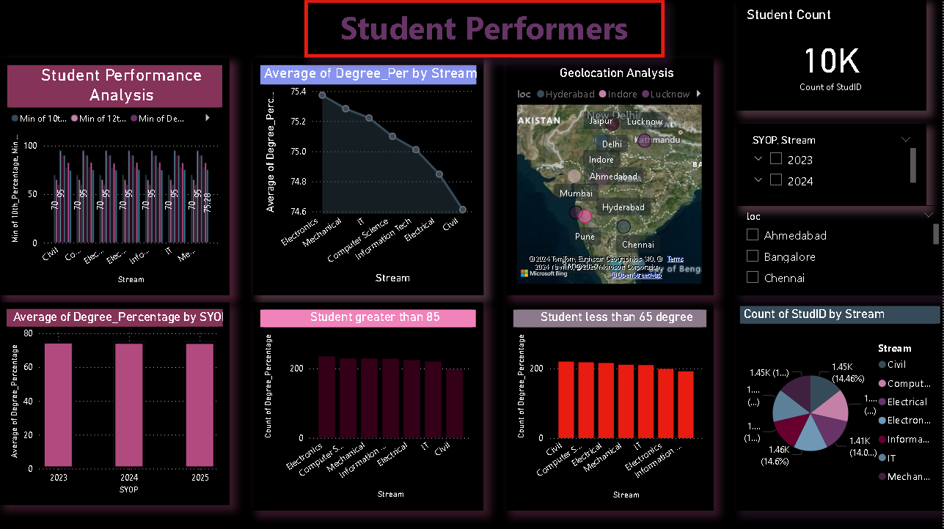
Gulfam Dashboard

Slide 17
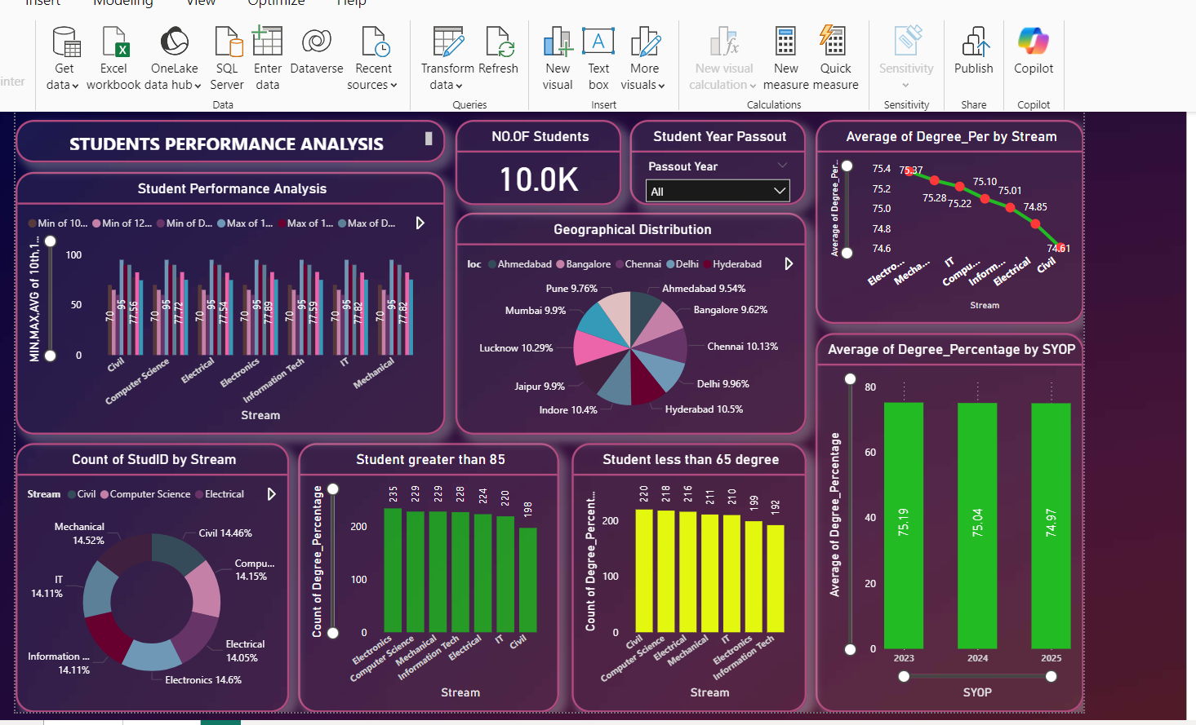
Day 20&21 PowerBI Visualization

